Slide 1
Abstract class
Data abstraction is the process of hiding certain details and showing only essential information to the user. Abstraction can be achieved with either abstract classes

Slide 2
Abstract Classes
The abstract keyword is a non-access modifier, used for classes and methods:
Abstract class: is a restricted class that cannot be used to create objects (to access it, it must be inherited from another class).
Example :
abstract class Shape { int color; // An abstract function abstract void draw(); }

Slide 3
Abstract class are follow:
An instance of an abstract class can not be created.
Constructors are allowed.
We can have an abstract class without any abstract method.
There can be a final method in abstract class but any abstract method in class(abstract class) can not be declared as final or in simpler terms final method can not be abstract itself as it will yield an error: “Illegal combination of modifiers: abstract and final”
We can define static methods in an abstract class
We can use the abstract keyword for declaring top-level classes (Outer class) as well as inner classes as abstract
If a class contains at least one abstract method then compulsory should declare a class as abstract
If the Child class is unable to provide implementation to all abstract methods of the Parent class then we should declare that Child class as abstract so that the next level Child class should provide implementation to the remaining abstract method

Slide 4
Abstract keyword
The abstract keyword in Java is used to declare a class or a method that cannot be instantiated directly or must be implemented by subclasses, respectively. It is a key part of Java's abstraction mechanism, allowing developers to define abstract classes and methods that provide a blueprint for other classes.
Abstract void print status();
// no method body and abstract

Slide 5
Interfaces
An interface in Java is a blueprint of a class. It has static constants and abstract methods.
The interface in Java is a mechanism to achieve abstraction. There can be only abstract methods in the Java interface, not method body. It is used to achieve abstraction and multiple inheritance in Java.

Slide 6
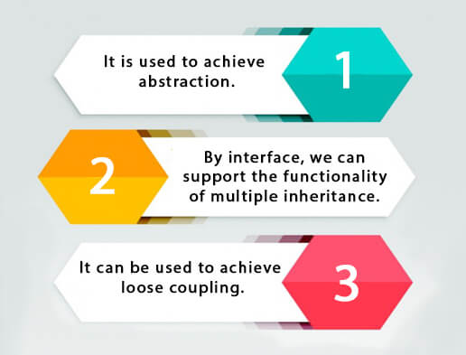
Use of interface
There are mainly three reasons to use interface. They are given below.
It is used to achieve abstraction.
By interface, we can support the functionality of multiple inheritance.
It can be used to achieve loose coupling.

Slide 7
Declare interface
An interface is declared by using the interface keyword. It provides total abstraction; means all the methods in an interface are declared with the empty body, and all the fields are public, static and final by default. A class that implements an interface must implement all the methods declared in the interface.
Syntax:
interface <interface_name>{
// declare constant fields
// declare methods that abstract
// by default.
}

Slide 8
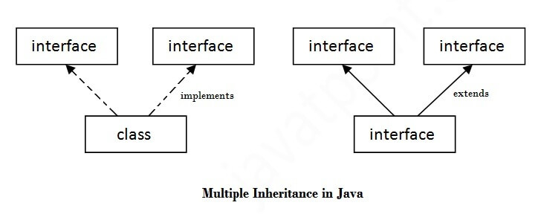
Multiple inheritance in Java by interface
If a class implements multiple interfaces, or an interface extends multiple interfaces, it is known as multiple inheritance.

Slide 9
Difference between abstract class and interface
Abstract class and interface both are used to achieve abstraction where we can declare the abstract methods. Abstract class and interface both can't be instantiated.
But there are many differences between abstract class and interface that are given slide.

Slide 10
Abstract class | interfaces
Abstract class can have abstract and non-abstract methods. | Interface can have only abstract methods. Since Java 8, it can have default and static methods also.
Abstract class doesn't support multiple inheritance. | Interface supports multiple inheritance
Abstract class can have final, non-final, static and non-static variables. | Interface has only static and final variables.
Abstract class can provide the implementation of interface. | Interface can't provide the implementation of abstract class.
The abstract keyword is used to declare abstract class. | The interface keyword is used to declare interface.
An abstract class can extend another Java class and implement multiple Java interfaces. | An interface can extend another Java interface only.
Example: public abstract class Shape{ public abstract void draw(); } | Example: public interface Drawable{ void draw(); }

Slide 11
Thank you
presented by kalaiyarasi k

